Slide 1

YAY! - Celebrating Education

Slide 2
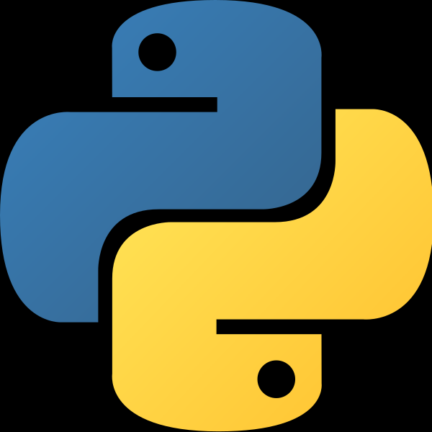

Python Course
(Basics)

Slide 3
Built-In Functions in Python

Slide 4
Course Agenda for Today
Python Map Function
Python Filter Function

Slide 5
Python Map Function
The map() function executes a specified function for each item in an iterable. The item is sent to the function as a parameter.
Syntax
map(function, iterables)
def myfunc(a, b):
return a + b
x = map(myfunc, ('apple', 'banana', 'cherry'), ('orange', 'lemon', 'pineapple'))
print(x)
#convert the map into a list, for readability:
print(list(x))

Slide 6
Python Filter Function
The filter() function returns an iterator were the items are filtered through a function to test if the item is accepted or not.
Syntax
filter(function, iterable)
ages = [5, 12, 17, 18, 24, 32] def myFunc(x): if x < 18: return False else: return True adults = filter(myFunc, ages) for x in adults: print(x)

Slide 7
Thank You!
See you in the next class!

